Slide 1
Transaction Processing and Error Recovery
Unit - 4

Slide 2
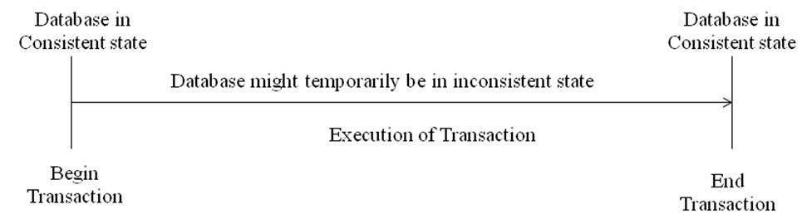
Transaction Concept
A transaction is a unit of program execution that accesses and possibly updates various data items.
A transaction is a logical unit of work that contains one or more SQL statements. The effects of all the SQL statements in a transaction can be either all committed or all rolled back.
A transaction that changes the contents of the database must alter the database from one consistent database state to another.

Slide 3
Transaction Concept
A transaction is a unit of program execution that accesses and possibly updates various data items.
E.g., transaction to transfer $50 from account A to account B:
1. read(A)
2. A := A – 50
3. write(A)
4. read(B)
5. B := B + 50
6. write(B)
Two main issues to deal with:
Failures of various kinds, such as hardware failures and system crashes
Concurrent execution of multiple transactions

Slide 4
Required Properties of a Transaction
Consider a transaction to transfer $50 from account A to account B:
1. read(A)
2. A := A – 50
3. write(A)
4. read(B)
5. B := B + 50
6. write(B)
Atomicity requirement
If the transaction fails after step 3 and before step 6, money will be “lost” leading to an inconsistent database state
Failure could be due to software or hardware
The system should ensure that updates of a partially executed transaction are not reflected in the database
Durability requirement — once the user has been notified that the transaction has completed (i.e., the transfer of the $50 has taken place), the updates to the database by the transaction must persist even if there are software or hardware failures.

Slide 5
Required Properties of a Transaction(contd..)
Consistency requirement in above example:
The sum of A and B is unchanged by the execution of the transaction
In general, consistency requirements include
Explicitly specified integrity constraints such as primary keys and foreign keys
Implicit integrity constraints
e.g., sum of balances of all accounts, minus sum of loan amounts must equal value of cash-in-hand
A transaction, when starting to execute, must see a consistent database.
During transaction execution the database may be temporarily inconsistent.
When the transaction completes successfully the database must be consistent
Erroneous transaction logic can lead to inconsistency

Slide 6
Required Properties of a Transaction(contd..)
Isolation requirement — if between steps 3 and 6 (of the fund transfer transaction) , another transaction T2 is allowed to access the partially updated database, it will see an inconsistent database (the sum A + B will be less than it should be).
T1 T2
1. read(A)
2. A := A – 50
3. write(A) read(A), read(B), print(A+B)
4. read(B)
5. B := B + 50
6. write(B
Isolation can be ensured trivially by running transactions serially
That is, one after the other.
However, executing multiple transactions concurrently has significant benefits, as we will see later.

Slide 7
ACID Properties
A transaction is a unit of program execution that accesses and possibly updates various data items.
Atomicity: Either all operations of the transaction are reflected properly in the database, or none are. Atomicity requires that all operations of a transaction be completed; if not, the transaction is aborted by rolling back all the updates done during the transaction.
Consistency: Consistency means execution of a transaction should preserve the consistency of the database, i.e. a transaction must transform the database from one consistent state to another consistent state.
Isolation: Though multiple transactions may execute concurrently, the system guarantees that, for every pair of transactions Ti and Tj , it appears to Ti that either Tj finished execution before Ti started or Tj started execution after Ti finished. Thus, each transaction is unaware of other transactions executing concurrently in the system.
Durability: After a transaction completes successfully, the changes it has made to the database persist, even if there are system failures. Durability ensures that once transaction changes are done or committed, they can’t be undone or lost, even in the event of a system failure.

Slide 8
Transaction States
Active state: This state is the initial state of a transaction. The transaction stays in this state while it is executing
Partial Committed state: A transaction is partial committed after its final statement has been executed. A transaction enters this state immediately before the commit statement
Failed state: A transaction enters the failed state after the discovery that normal execution can no longer proceed
Aborted state: A transaction is aborted after it has been rolled back and the database is restored to its prior state before the transaction
Committed state: Committed state occurs after successful completion of the transaction
Terminate: Transaction is either committed or aborted

Slide 9
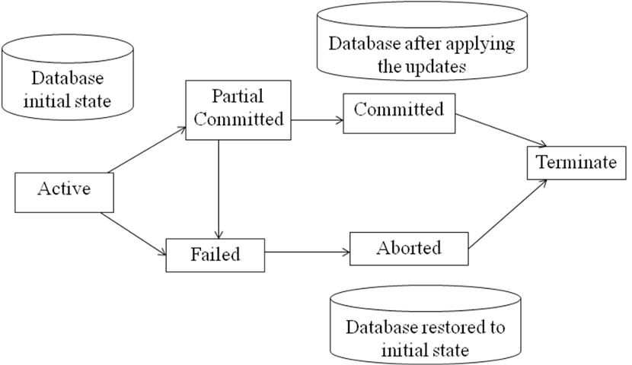
Transaction States
When a transaction enters the aborted state, the system has two options:
Restart the transaction: If the transaction was aborted as a result of a hardware failure or some software error (other than logical error), it can be restarted
Kill the transaction: If the application program that initiated the transaction has some logical error

Slide 10
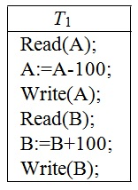
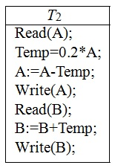
Concurrent Execution
Concurrent execution of transactions means executing more than one transaction at the same time.
In the serial execution, one transaction can start executing only after the completion of the previous.
The advantages of using concurrent execution of transactions are:
Improved throughput and resource utilization.
Reduced waiting time.
The database system must control the interaction among the concurrent transactions to prevent them from destroying the consistency of the database. It does this through a variety of mechanisms called concurrency control schemes.
T1 transfers $100 from account A to account B
T2 transfers 20% of balance from account A to account B

Slide 11
Schedule & Serial Schedule
Concurrent execution of transactions means executing more than one transaction at the same time.
A schedule is a sequence that indicates the chronological order in which instructions of concurrent transactions are executed.
A schedule for a set of transactions must consist of all instructions of those transactions.
We must preserve the order in which the instructions appear in each individual transaction.
Serial Schedule:
A serial schedule is a schedule where all the instructions belonging to each transaction appear together.
There is no interleaving of transaction operations. A serial schedule has no concurrency and therefore it does not interleave the actions of different transactions.
For n transactions, there are exactly n! different serial schedules possible.

Slide 12
Serial Schedule…
T1 | T2
Read(A); | Read(A);
A:=A-100;
Write(A);
Read(B);
B:=B+100;
Write(B);
 | Temp=0.2*A;
 | A:=A-Temp;
 | Write(A);
 | Read(B);
 | B:=B+Temp;
 | Write(B);
T1 | T2
Read(A); | Read(A);
 | Temp=0.2*A;
 | A:=A-Temp;
 | Write(A);
 | Read(B);
 | B:=B+Temp;
 | Write(B);
A:=A-100;
Write(A);
Read(B);
B:=B+100;
Write(B);
Schedule1
(T1 followed by T2)
Schedule2
(T₂ followed by T₁)

Slide 13
Concurrent Schedule
In concurrent schedule, operations from different concurrent transactions are interleaved.
The number of possible schedules for a set of n transactions is much larger than n!.
T1 | T2
Read(A); | Read(A);
A:=A-100;
Write(A);
 | Temp=0.2*A;
 | A:=A-Temp;
 | Write(A);
Read(B);
B:=B+100;
Write(B);
 | Read(B);
 | B:=B+Temp;
 | Write(B);
T1 | T2
Read(A); | Read(A);
A:=A-100;
 | Temp=0.2*A;
 | A:=A-Temp;
 | Write(A);
 | Read(B);
Write(A);
Read(B);
B:=B+100;
Write(B);
 | B:=B+Temp;
 | Write(B);
T1 | T2
Read(A); | Read(A);
A:=A-100;
Write(A);
 | Temp=0.2*A;
 | A:=A-Temp;
Read(B);
B:=B+100; Write(B);
 | Write(A);
 | Read(B);
 | B:=B+Temp;
 | Write(B);
Schedule 3
Schedule 4
Schedule 5

Slide 14
Serializability
A concurrent schedule is serializable if it is equivalent to a serial schedule.
Serial schedules preserve consistency as we assume each transaction individually preserves consistency.
The database system must control concurrent execution of transactions to ensure that the database state remains consistent.
Since the modifications are done in the local buffer, we can ignore the operations other than Read and Write instructions for easier understanding of the serializability.

Slide 15
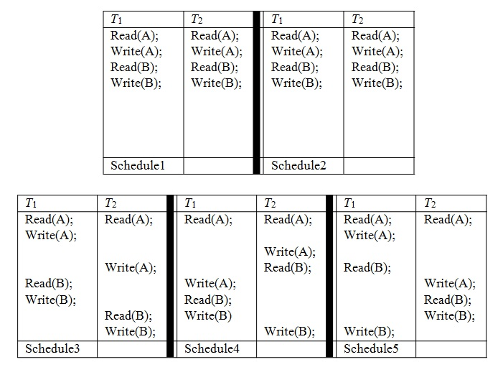
Serializability

Slide 16
Conflict Serializability
A schedule is called conflict serializability if after swapping of non-conflicting operations, it can transform into a serial schedule.
The schedule will be a conflict serializable if it is conflict equivalent to a serial schedule.
Conflicting Operations
The two operations become conflicting if all conditions satisfy:
Both belong to separate transactions.
They have the same data item.
They contain at least one write operation.

Slide 17
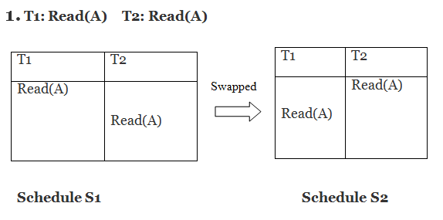
Conflict Serializability…
Example:
Swapping is possible only if S1 and S2 are logically equal.
Here, S1 = S2. That means it is non-conflict.

Slide 18
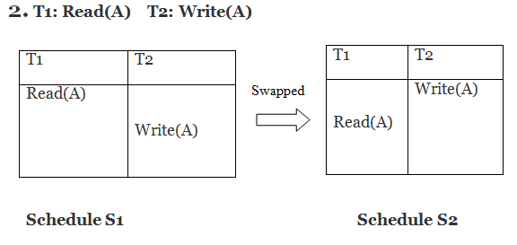
Conflict Serializability…
Here, S1 ≠ S2. That means it is conflict.

Slide 19
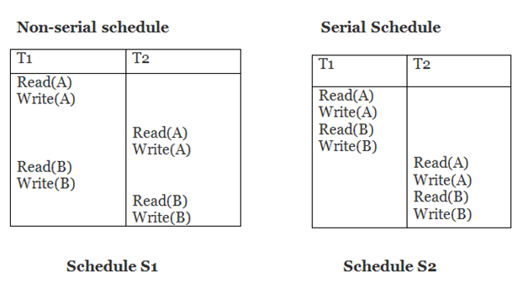
Conflict Serializability…
Conflict Equivalent
In the conflict equivalent, one can be transformed to another by swapping non-conflicting operations. In the given example, S2 is conflict equivalent to S1 (S1 can be converted to S2 by swapping non-conflicting operations).
Two schedules are said to be conflict equivalent if and only if:
They contain the same set of the transaction.
If each pair of conflict operations are ordered in the same way.
Schedule S2 is a serial schedule because, in this, all operations of T1 are performed before starting any operation of T2. Schedule S1 can be transformed into a serial schedule by swapping non-conflicting operations of S1.

Slide 20
Conflict Serializability…
After swapping of non-conflict operations, the schedule S1 becomes:
T1 T2
Read(A)
Write(A)
Read(B)
Write(B)
Read(A)
Write(A)
Read(B)
Write(B)
Since, S1 is conflict serializable.

Slide 21
Testing for Conflict Serializability
Construct a directed graph, called a precedence graph from S. This graph consists of a pair G = (V, E), where V is a set of vertices and E is a set of edges.
The set of vertices consists of all the transactions participating in the schedule.
The set of edges consists of all edges Ti → Tj for which one of three conditions holds:
Ti executes write(Q) before Tj executes read(Q)
Ti executes read(Q) before Tj executes write(Q)
Ti executes write(Q) before Tj executes write(Q)
If an edge Ti → Tj exists in the precedence graph, then in any serial schedule S’ equivalent to S, Ti must appear before Tj.
If the precedence graph for a concurrent schedule S has a cycle, then that schedule is not conflict serializable. If the graph contains no cycles, then the schedule S is conflict serializable.

Slide 22
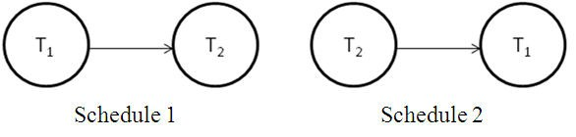
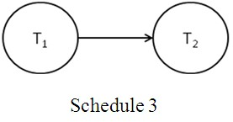
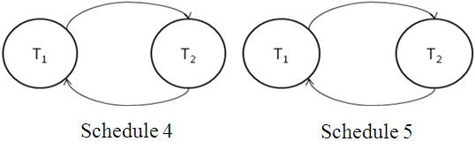
Testing for Conflict Serializability

Slide 23
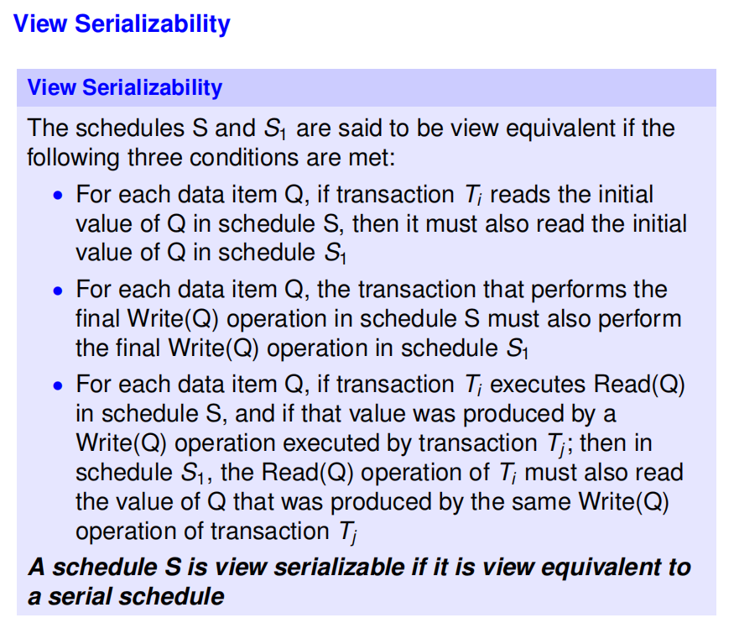

Slide 24
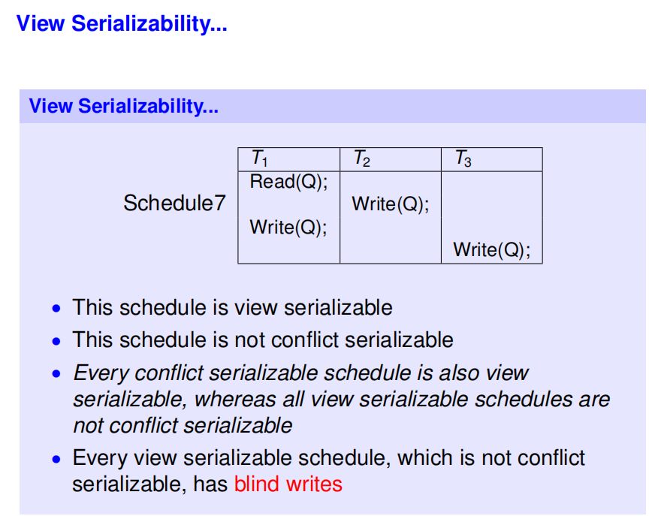

Slide 25
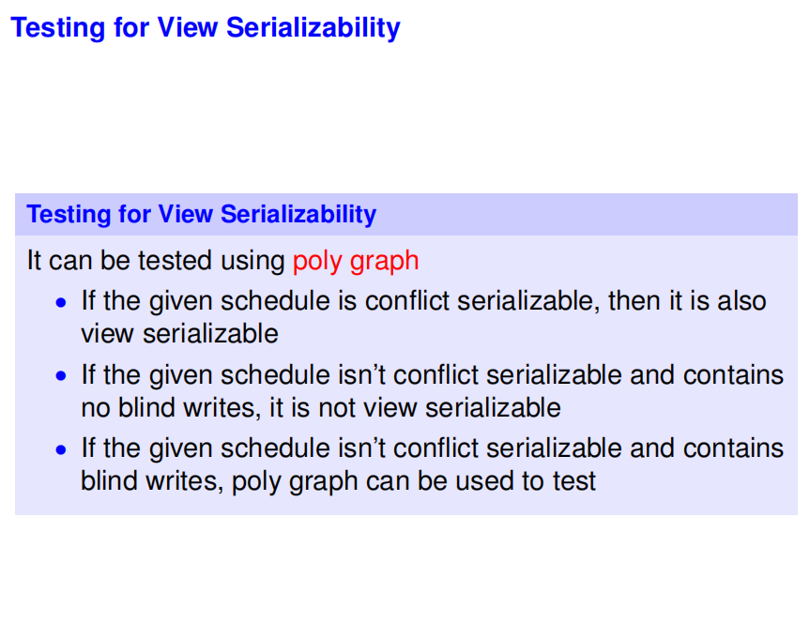

Slide 26
Concurrency Control
In the concurrency control, the multiple transactions can be executed simultaneously.
It may affect the transaction result.
It is highly important to maintain the order of execution of those transactions

Slide 27
Need of Concurrency Control
Several problems can occur when concurrent transactions are executed in an uncontrolled manner.
Following are the three problems in concurrency control.
Lost updates
Dirty read
Unrepeatable read

Slide 28
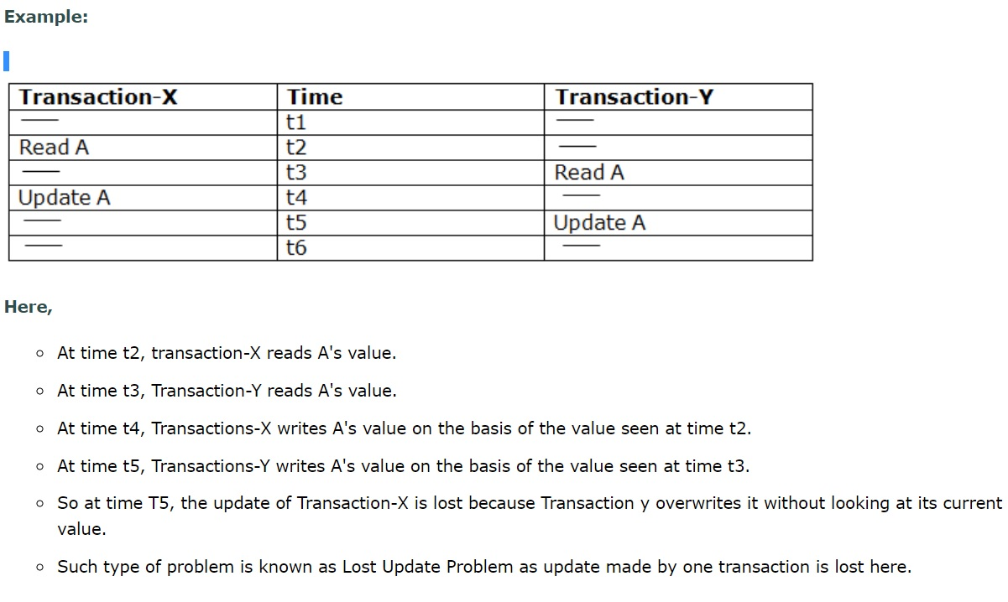
1. Lost update problem
When two transactions that access the same database items contain their operations in a way that makes the value of some database item incorrect, then the lost update problem occurs.
If two transactions T1 and T2 read a record and then update it, then the effect of updating of the first record will be overwritten by the second update.

Slide 29
Dirty Read Problem
The dirty read occurs in the case when one transaction updates an item of the database, and then the transaction fails for some reason. The updated database item is accessed by another transaction before it is changed back to the original value.
A transaction T1 updates a record which is read by T2. If T1 aborts then T2 now has values which have never formed part of the stable database.

Slide 30
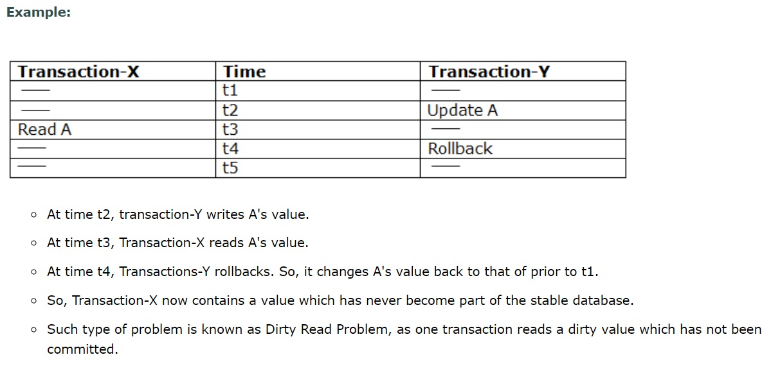
2. Dirty Read Problem - Example

Slide 31
3. Inconsistent Retrievals / unrepeatable read Problem/Incorrect Summary Problem
Inconsistent Retrievals Problem is also known as unrepeatable read.
When a transaction calculates some summary function over a set of data while the other transactions are updating the data, then the Inconsistent Retrievals Problem occurs.
A transaction T1 reads a record and then does some other processing during which the transaction T2 updates the record. Now when the transaction T1 reads the record, then the new value will be inconsistent with the previous value.

Slide 32
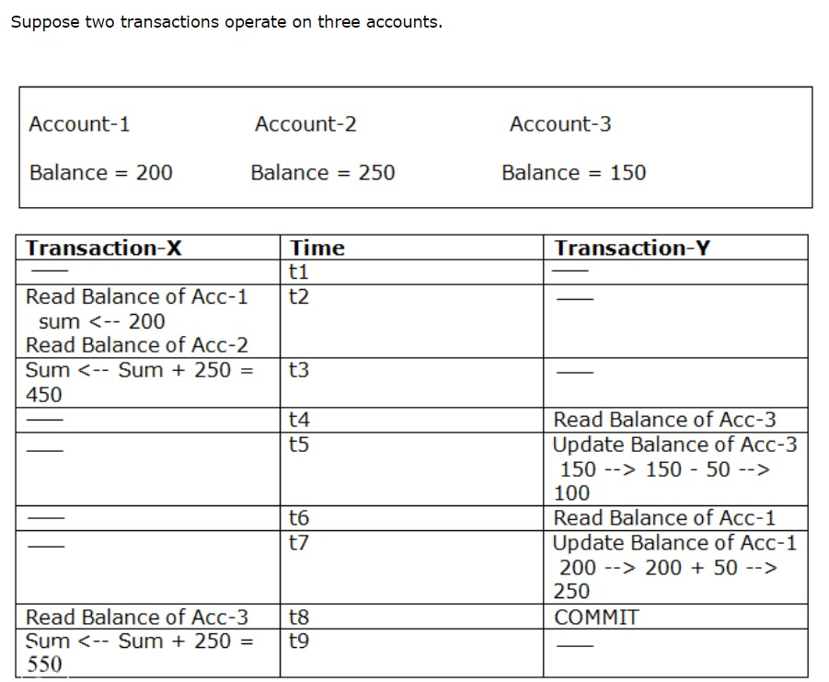
Unrepeatable read - Example

Slide 33
Unrepeatable read - Example
Transaction-X is doing the sum of all balance while transaction-Y is transferring an amount 50 from Account-1 to Account-3.
Here, transaction-X produces the result of 550 which is incorrect. If we write this produced result in the database, the database will become an inconsistent state because the actual sum is 600.
Here, transaction-X has seen an inconsistent state of the database.

Slide 34
Concurrency Control Protocol
Concurrency control protocols ensure atomicity, isolation, and serializability of concurrent transactions. The concurrency control protocol can be divided into three categories:
Lock based protocol
Time-stamp protocol
Validation based protocol

Slide 35
Lock-Based Protocols
Locking is a procedure used to control concurrent access to data. Locks enable a multi-user database system to maintain the integrity of transactions by isolating a transaction from others executing concurrently.
Locking is one of the most widely used mechanisms to ensure serializability.
A lock guarantees exclussive use of a data item to a current transaction.
to access data item [Lock Acquire]
After completion if transaction [Release the Lock]

Slide 36
Lock-Based Protocols
Types of Lock:
Data items can be locked in two modes:
Shared Lock (Lock-S)
Exclussive Lock (Lock-X)
Shared lock or Read lock:
It is also known as a Read-only lock. In a shared lock, the data item can only read by the transaction.
It can be shared between the transactions because when the transaction holds a lock, then it can't update the data on the data item.
If a transaction Ti has obtained a shared mode lock(S) on data item Q, then Ti can only read the data item Q, but cannot write on Q.

Slide 37
Lock-Based Protocols
2. Exclusive lock or Write lock:
In the exclusive lock, the data item can be both reads as well as written by the transaction.
This lock is exclusive, and in this lock, multiple transactions do not modify the same data simultaneously.
If a transaction Ti has obtained an exclusive mode lock(X) on data item Q, then Ti can both read and write Q.
A transaction must obtain a lock on a data item before it can perform a read or write operation.

Slide 38
Lock-Based Protocols
Compatiblity between Lock Model :
Basic Rules for Locking:
If a transaction has a read lock on a data item, it can only read the item; but cannot update its value.
If a transaction has a read lock on a data item, other transactions can obtain read locks on the same data item, but they cannot obtain any update lock on it.
If a transaction has a write lock on a data item, then it can both read and update the value of that data item.
If a transaction has a write lock on a data item, then other transactions cannot obtain either a read lock or a write lock on that data item.
request
 | S | X
S | Allowed (True) | Not Allowed (False)
X | Not Allowed (False) | Not Allowed (False)
grant

Slide 39
Lock-Based Protocols
T1 | T2
Lock-X (B) R(B) B=B-50 W(B) unlock(B)
 | Lock-S(B) Read (B) unlock(B)
Note:
Any number of transaction can hold shared lock but exclussive lock can be hold by one transaction at a time.

Slide 40
Basic Rules for Locking
A transaction requests a shared lock on data item Q by executing the Lock-S(Q) instruction.
Similarly, a transaction can request an exclusive lock through the Lock-X(Q) instruction.
A transaction can unlock a data item Q by the Unlock(Q) instruction.

Slide 41
Working of Locking
All transactions that need to access a data item must first acquire a read lock or write lock on the data item depending on whether it is a read only operation or not.
If the data item for which the lock is requested is not already locked, then the transaction is granted with the requested lock immediately.
If the item is currently locked, the database system determines what kind of lock is the current one. Also, it finds out which type of lock is requested:
If a read lock is requested on a data item that is already under a read lock, then the request will be granted.
If a write lock is requested on a data item that is already under a read lock, then the request will be denied.
Similarly; if a read lock or a write lock is requested on a data item that is already under a write lock, then the request is denied and the transaction must wait until the lock is released.
A transaction continues to hold the lock until it explicitly releases it either during the execution or when it terminates.
The effects of a write operation will be visible to other transactions only after the lock is released.

Slide 42
Problem in shared and Exclusive locking
May not sufficient to produce only serializable schedule
May not free from Irrecoverability
May not free from deadlock
May not free from starvation

Slide 43
Two-Phase Locking Protocol
Two-phase locking protocol is a protocol which ensures serializability.
This protocol requires that each transaction issues lock and unlock requests in two phases.
The two phases are:
Growing phase: Here, a transaction acquires all required locks without unlocking any data, i.e. the transaction may not release any lock
Shrinking phase: Here, a transaction releases all locks and cannot obtain any new lock
The point in the schedule where the transaction has obtained its final lock is called the lock point of the transaction.
Transactions can be ordered according to their lock points.

Slide 44
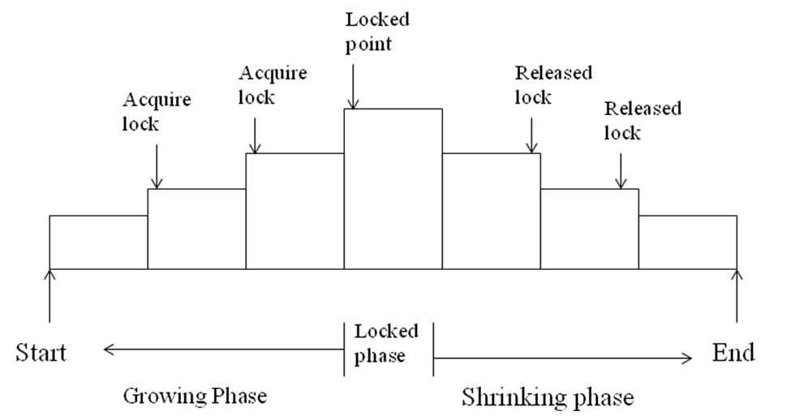
Two-Phase Locking Protocol…
Two transactions cannot have conflicting locks.
No unlock operation can precede a lock operation in the same transaction.
No data are affected until all locks are obtained, i.e. until the transaction is in its locked point.

Slide 45
2PL locking
Advantages: always ensures serializability
Disadvantages:
May not free from irrecoverability
Not free from dead lock
Not free from starvation
Not free from cascading Rollback

Slide 46
Variations of Two-Phase Locking Protocol
2PL Locking Protocal has 3 variations:
1. Conservative (Static) 2PL, 2. Strict 2PL, 3. Regrous 2PL
1. Conservative (Static) 2PL:
Acquires all the locks before it starts
Release all locks after commit.
Avoids cascading rollback
It is deadlock free
2. Strict 2PL
Exclussive lock cannot be realse untill commit.
Helps in cascade schedule.
Deadlock may occur.
3. Regrous 2PL
Both shared and exclussive lock cannot release untill commit.
Avoids cascading rollback
Deadlock may occur

Slide 47
Two-Phase Locking Protocol
Two-phase locking does not ensure freedom from deadlock. Along with the serializability property, the schedules should be cascade-less in nature.
Cascading rollback is possible under two-phase locking protocol.
T₄ | T₅ | T₆
Lock-X(A); Read(A); Lock-S(B); Read(B); Write(A); Unlock(A); | Lock-X(A); Read(A); Write(A); Unlock(A); | Lock-S(A); Read(A);
Schedule 7

Slide 48
Two-Phase Locking Protocol
Cascading rollbacks can be avoided by a modification of the original two-phase locking protocol called strict two-phase locking protocol. In this protocol, a transaction must hold all its exclusive locks till it commits or aborts.
Rigorous two-phase locking protocol is even stricter, which requires that all the locks be held until the transaction commits or aborts. In this protocol, transactions can be serialized in the order in which they commit.
Most database systems implement either strict or rigorous two-phase locking.

Slide 49
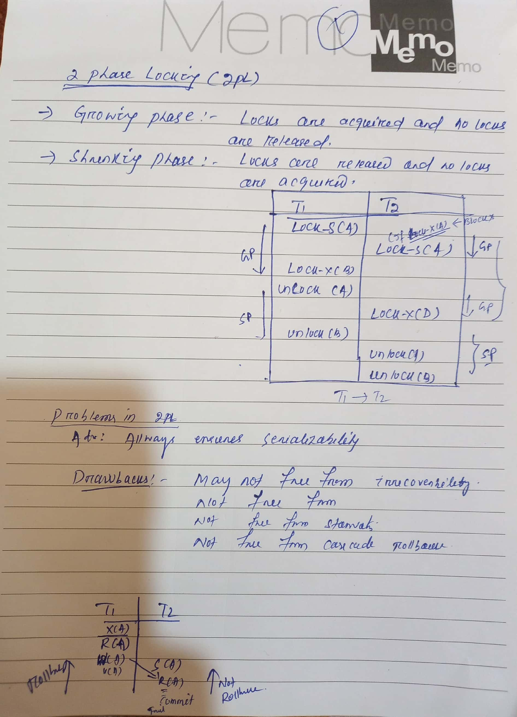
Two-Phase Locking Protocol

Slide 50
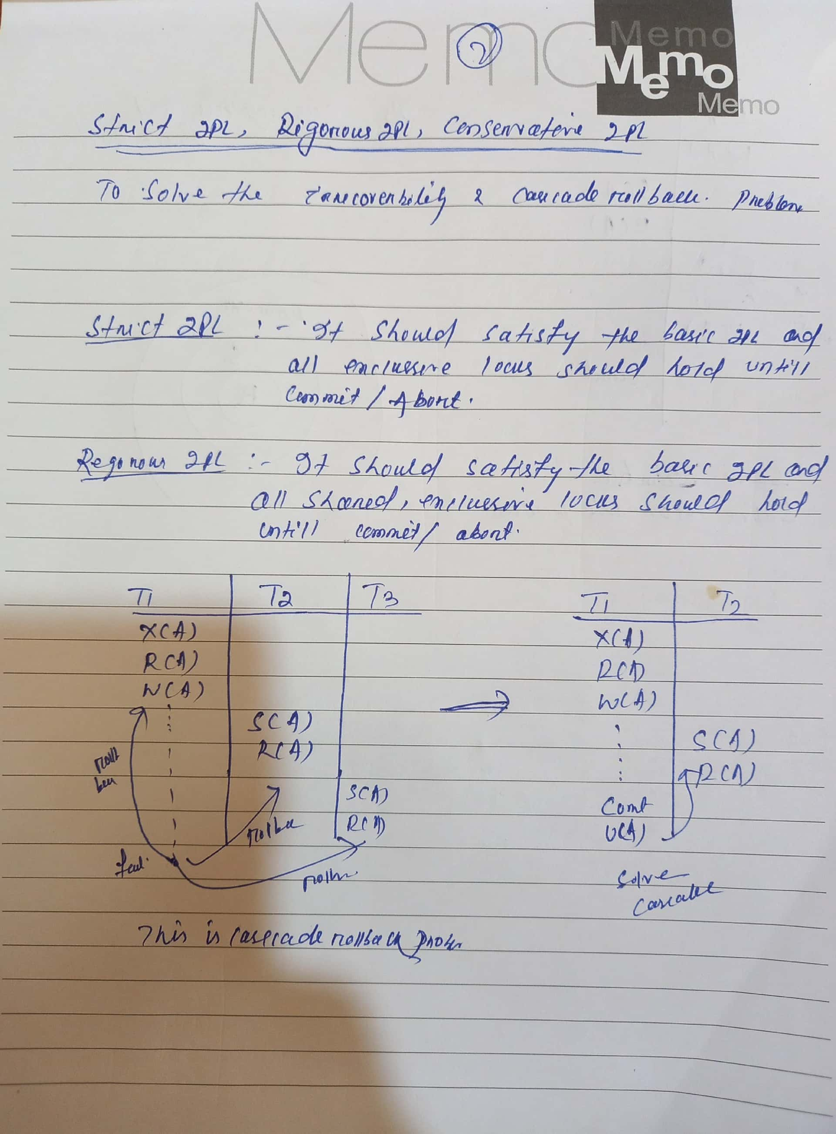
Two-Phase Locking Protocol

Slide 51
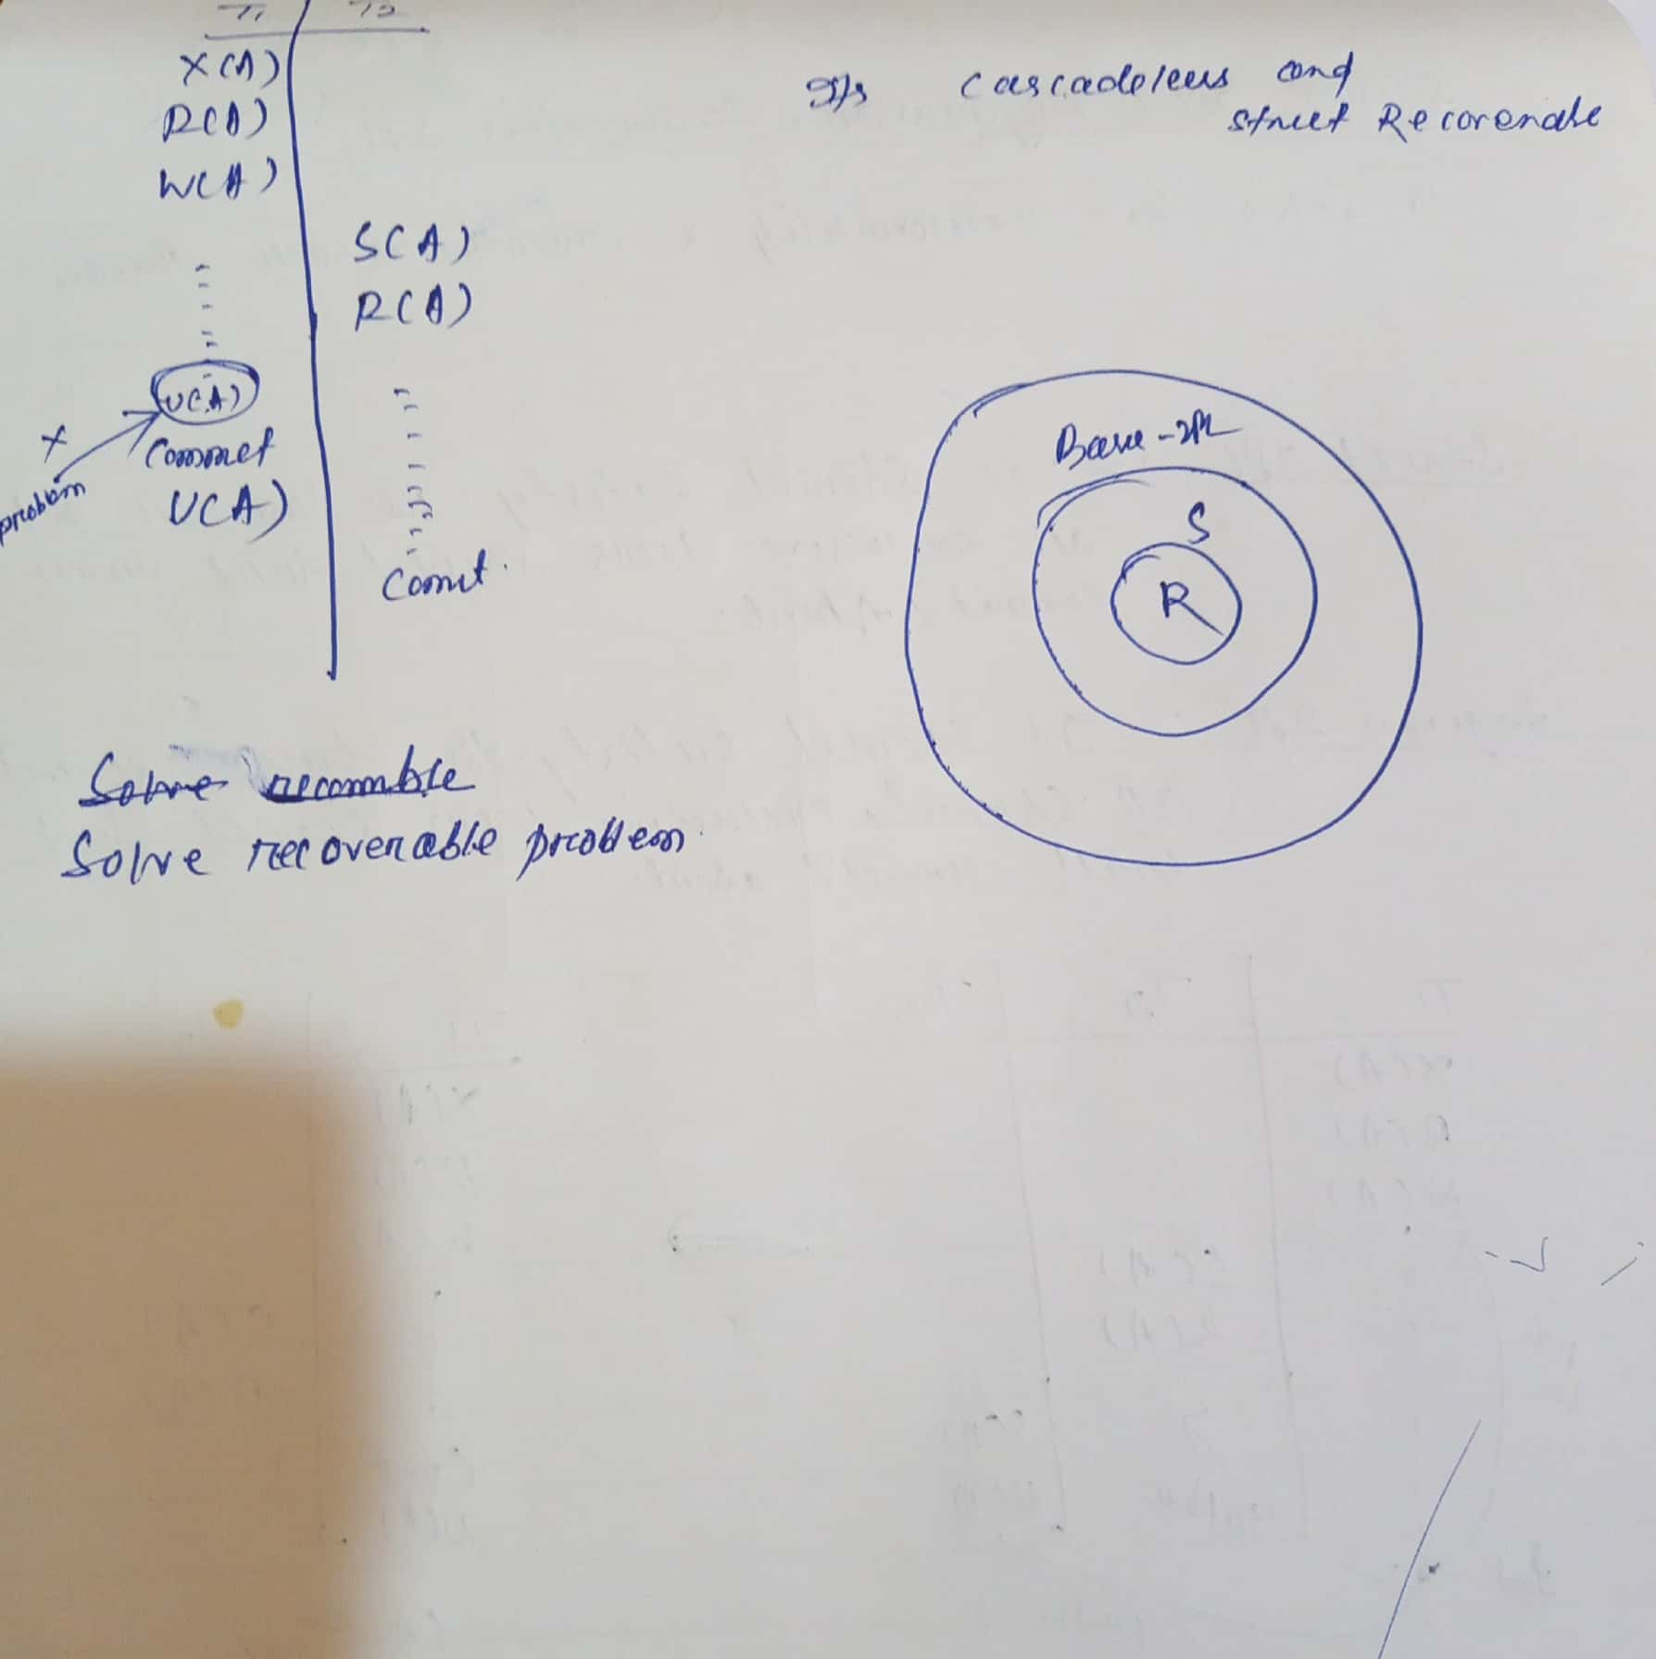
Two-Phase Locking Protocol

Slide 52
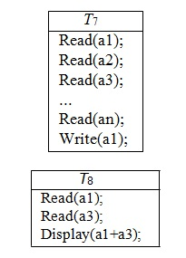
Lock Conversions
Lock Upgrade: This is the process in which a shared lock is upgraded to an exclusive lock.(Read-Lock -> Write Lock)
Lock Downgrade: This is the process in which an exclusive lock is downgraded to a shared lock.( Write Lock -> Read-Lock )
Lock upgrading can take place only in the growing phase, where as lock downgrading can take place only in the shrinking phase.

Slide 53
Lock Conversions…
Thus, the two-phase locking protocol with lock conversions:
First Phase:
Can acquire a lock-S on item
Can acquire a lock-X on item
Can convert a lock-S to a lock-X (upgrade)
Second Phase:
Can release a lock-S
Can release a lock-X
Can convert a lock-X to a lock-S (downgrade)
Like the basic two-phase locking protocol, two-phase locking with lock conversion generates only conflict-serializable schedules and transactions can be serialized by their lock points.
If the exclusive locks are held until the end of the transaction, then the schedules became cascade-less.

Slide 54
Timestamp Method
A timestamp is atag that can be attached to any transaction or any data item,which denotes specific time or which the transaction or data item had been activated in any way.
Methods to Implement Time stamp:
System Clock as timestamp
Logical counter that is incremented after a new timestamp has been assigned.
Transaction | time by system clock | Time Stamp
T1 | 9.00 a.m | Ts(1)
. . |  | . .
T2 | 9.05 a.m | Ts(2)
so Ts(1) < Ts(2)

Slide 55
Timestamp Method
Timestamp TS (Ti ) is assigned by the database system before the transaction Ti starts its execution.
The timestamps of the transactions determine the serializability order. Thus, if TS(Ti ) < TS(Tj ), then the system must ensure that the produced schedule is equivalent to a serial schedule in which Ti appears before Tj.
There are two timestamp values associated with each data item Q:
W-Timestamp(Q): It denotes the largest timestamp of any transaction that executed write(Q) operation successfully
R-Timestamp(Q): It denotes the largest timestamp of any transaction that executed read(Q) operation successfully

Slide 56
Timestamp Ordering Protocols
This ensures that any conflicting read and write operations are executed in timestamp order
Suppose transaction Ti issues read(Q):
If TS(Ti ) < W-TS(Q), then Ti needs to read a value of Q that was already overwritten. Hence, the read operation is rejected and Ti is rolled back.
If TS(Ti ) ≥ W-TS(Q), then the read operation is executed, and R-TS(Q) is set to maximum of R-TS(Q) and TS(Ti ).
Suppose transaction Ti issues write(Q):
If TS(Ti ) < R-TS(Q), then the value of Q that Ti is producing was needed previously, and the system assumed that the value would never be produced. Hence, the system rejects the write operation and rolls Ti back.
If TS(Ti ) < W-TS(Q), then Ti is attempting to write an obsolete value of Q. Hence, the system rejects this write operation and rolls Ti back.
Otherwise, the system executes the write operation and sets W-TS (Q) to TS (Ti ).

Slide 57
Timestamp Ordering Protocols…
From the above examples, we can say that the timestamp ordering protocol always ensures conflict serializability. This is because conflicting operations are processed in timestamp order.
The protocol ensures freedom from deadlock, since no transaction ever waits
However, there is a possibility of starvation of long transactions if a sequence of conflicting short transactions causes repeated restarting of the long transaction
If a transaction is found to be getting restarted repeatedly; conflicting transactions need to be temporarily blocked to enable the transaction to finish

Slide 58
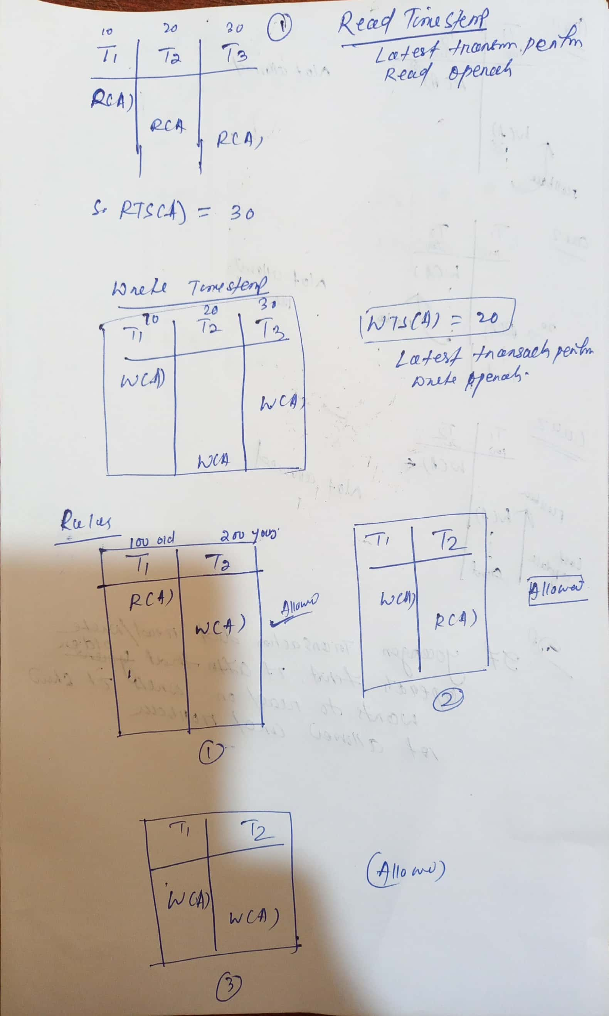
Timestamp Ordering Protocols

Slide 59
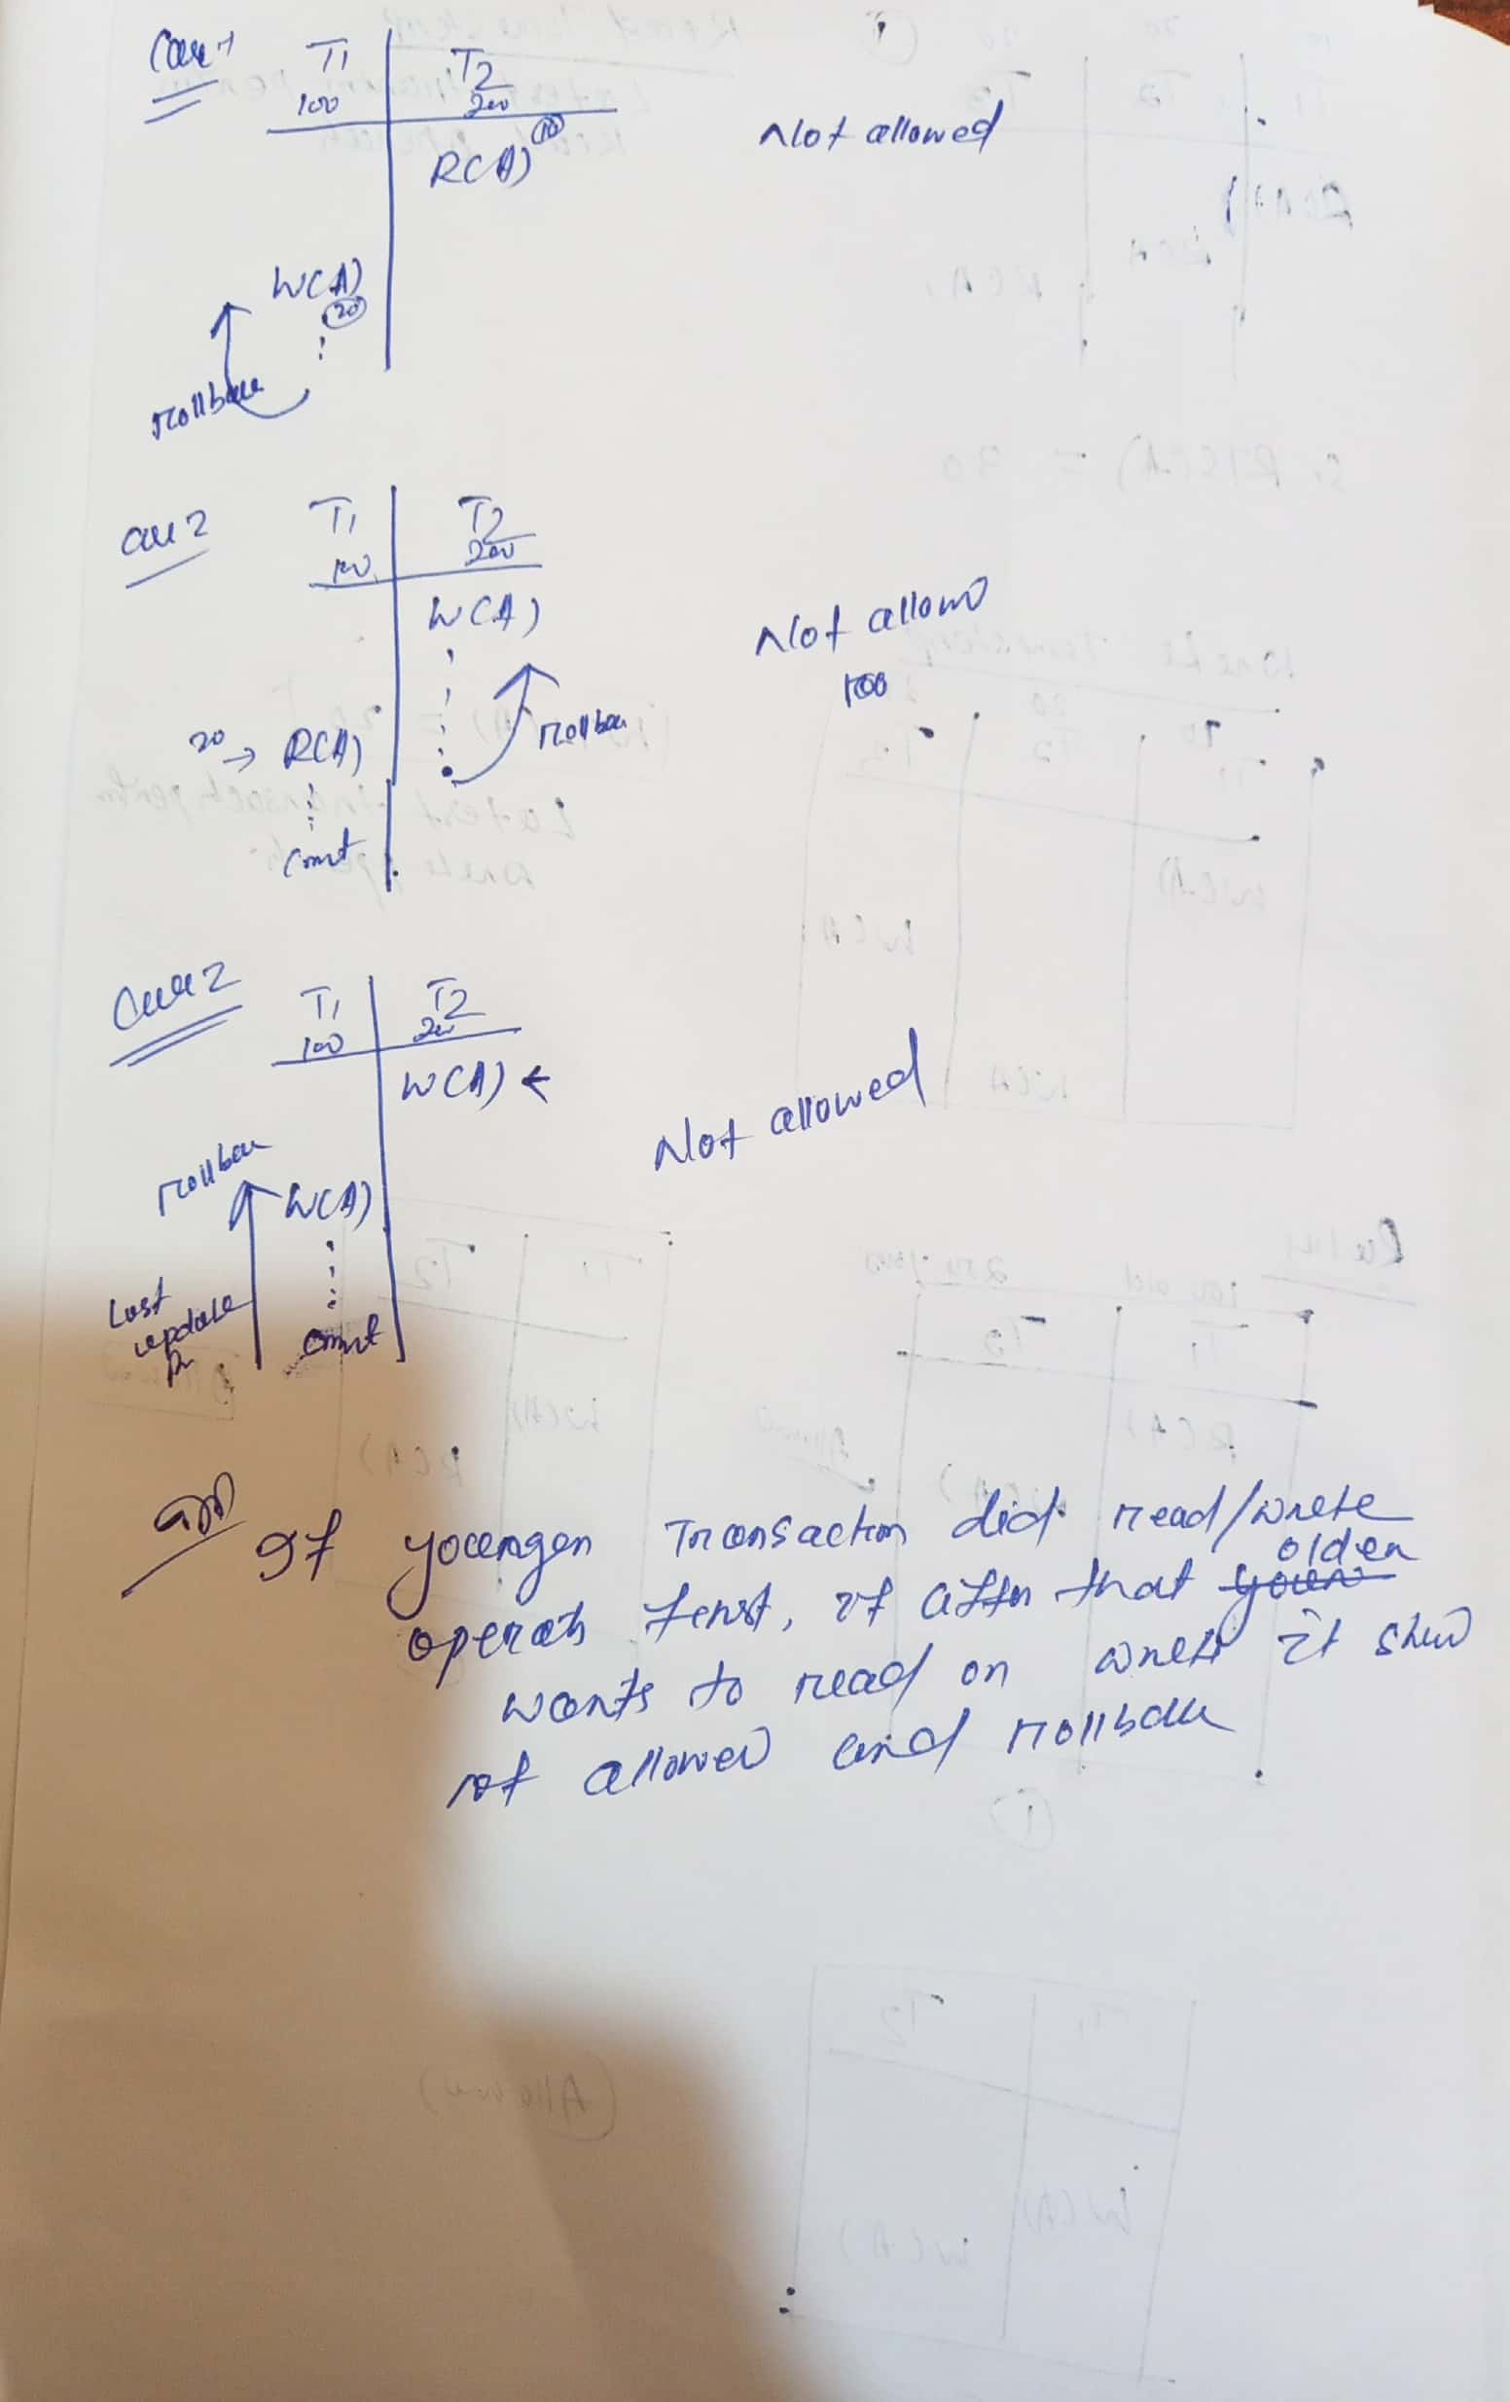
Timestamp Ordering Protocols

Slide 60
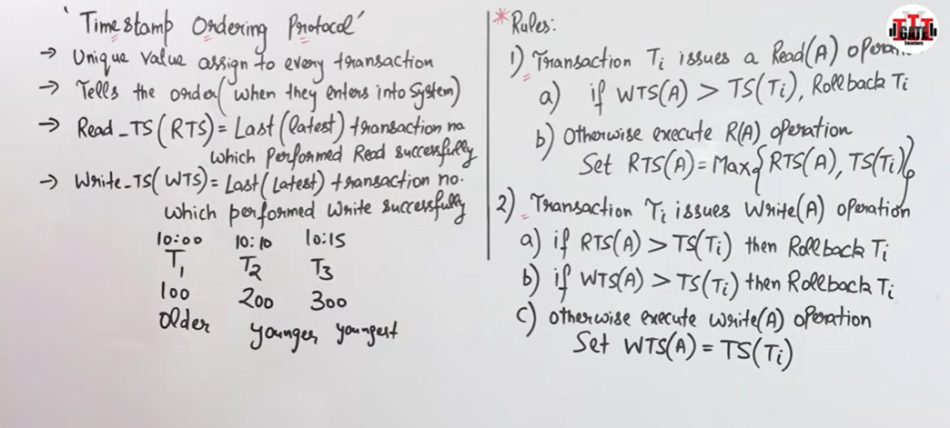
Example- Find out Which transaction is doing Rollback

Slide 61
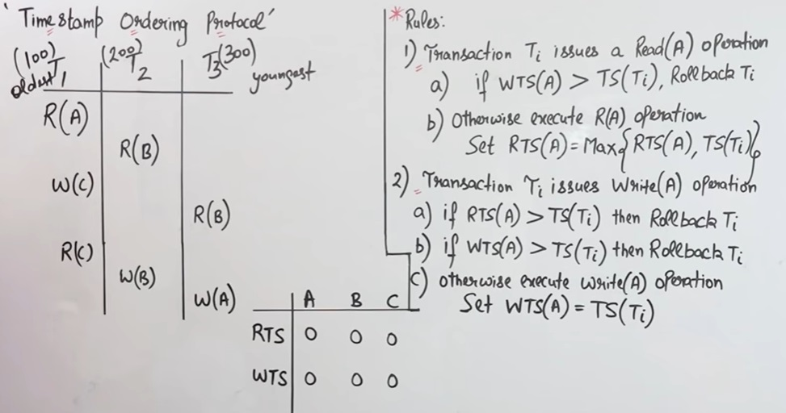
Example- Find out Which transaction is doing Rollback

Slide 62
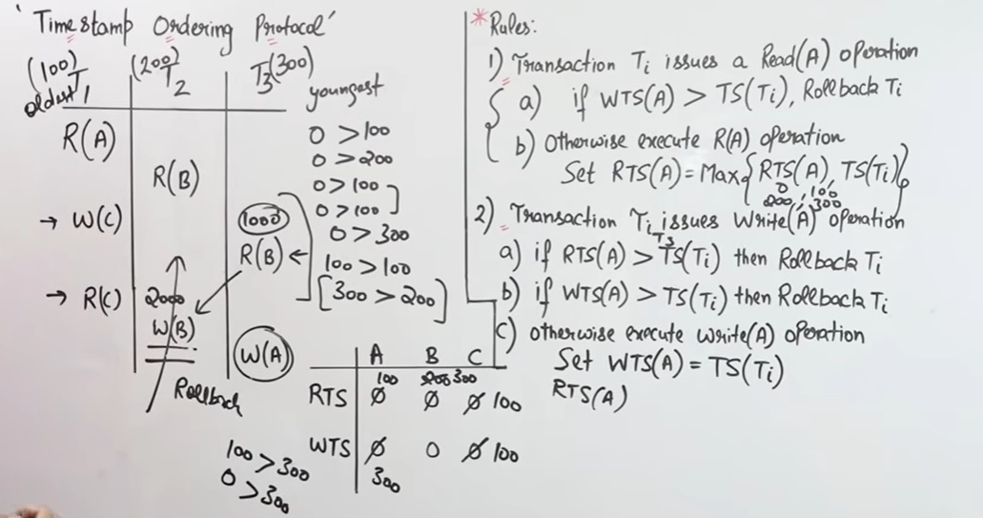
Example- Find out Which transaction is doing Rollback

Slide 63
Timestamp Ordering Protocols…
T1 | T2
R(A)
 | W(A)
W(A)
Here the order is T1 ->T2, so in the above example R(A)->W(A) is correct . but after that W(A)-> W(A) is not correct because first T1 then T2 will do the work. Reject and rollback.
T1 | T2
R(A)
 | R(A)
W(A)

Slide 64
Problems with Timestamp Ordering Protocols…
Suppose Ti aborts, but Tj has read a data item written by Ti . Then, Tj must abort; if Tj had been allowed to omit earlier, the schedule is not recoverable. Further, any transaction that has read a data item written by Tj must abort. This can lead to cascading rollback; i.e. chain of rollbacks.
The solutions to this type of problem are:
A transaction is structured in such a way that its writes are performed at the end of its processing. At the same time, all writes of a transaction form an atomic action; i.e. no transaction may execute while a transaction is being written, or
Wait for the data to be committed before reading it.

Slide 65
Thomas write Rule
Thomas Write Rule provides the guarantee of serializability order for the protocol. It improves the Basic Timestamp Ordering Algorithm.
The basic Thomas write rules are as follows:
If TS(T) < R_TS(X) then transaction T is aborted and rolled back, and operation is rejected.
oIf TS(T) < W_TS(X) then don't execute the W_item(X) operation of the transaction and continue processing.
If neither condition 1 nor condition 2 occurs, then allowed to execute the WRITE operation by transaction Ti and set W_TS(X) to TS(T).
If we use the Thomas write rule then some serializable schedule can be permitted that does not conflict serializable as illustrate by the schedule in a given figure:

Slide 66
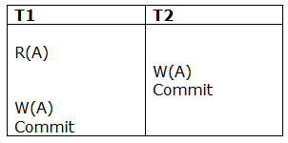
Thomas write Rule
Figure: A Serializable Schedule that is not Conflict Serializable
In the above figure, T1's read and precedes T1's write of the same data item. This schedule does not conflict serializable.
Thomas write rule checks that T2's write is never seen by any transaction. If we delete the write operation in transaction T2, then conflict serializable schedule can be obtained which is shown in below figure.

Slide 67
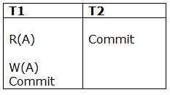
Thomas write Rule
Figure: A Conflict Serializable Schedule
Link: time stamp: https://www.youtube.com/watch?v=h60vaqrXHO8

Slide 68
Recovery System
The recovery manager of a database system is responsible for ensuring two important properties of transactions:
Atomicity
Durability
It ensures the atomicity by undoing the actions of transactions that do not commit.
It ensures the durability by making sure that all actions of committed transactions survive in case of system crashes and media failures.

Slide 69
Log-Based Recovery
Log is a sequence of log records, recording all the update activities in the database. It is kept on stable storage
There are several types of log records. An update log record describes a single database write. It has the following fields:
Transaction Identifier : This is the unique identifier of the transaction that performed the write operation
Data-item Identifier : This is the unique identifier of the data item written. Typically, it is the location on disk of the data item
Old Value: This is the value of the data item prior to the write operation
New Value: This is the value that the data item will have after the write operation
Various types of log records are:
<Ti start>: Transaction Ti has started
<Ti , xj ,v1,v2>: Transaction Ti has performed a write operation on the data item xj . This data item xj had value v1 before the write, and will have value v2 after the write
<Ti commit>: Transaction Ti has committed

Slide 70
Log-Based Recovery…
<Ti abort>: Transaction Ti has aborted
When a transaction performs a write operation, it is essential that the log record for that write be created before the database is modified.
For log records to be useful for recovery from system and disk failures, the log must reside in stable storage.
The log contains a complete record of all database activities.

Slide 71
Database Modification
This scheme ensures transaction atomicity by recording all the database modifications in the log, but deferring the execution of all write operations of a transaction until the transaction partially commits.
The execution of transaction Ti proceeds as follows:
Before Ti starts its execution, a record <Ti start> is written to the log.
A write(X) operation by Ti results in the writing of a new record to the log as <Ti , X, V>, where V is the new value of X. For this scheme, the old value is not required.
When Ti partially commits, a record <Ti commit> is written to the log.

Slide 72
Database Modification…
There are two approaches to modify the database:
1. Deferred database modification:
The deferred modification technique occurs if the transaction does not modify the database until it has committed.
In this method, all the logs are created and stored in the stable storage, and the database is updated when a transaction commits.
2. Immediate database modification:
The Immediate modification technique occurs if database modification occurs while the transaction is still active.
In this technique, the database is modified immediately after every operation. It follows an actual database modification.

Slide 73
Recovery using Log records
When the system is crashed, then the system consults the log to find which transactions need to be undone and which need to be redone.
If the log contains the record <Ti, Start> and <Ti, Commit> or <Ti, Commit>, then the Transaction Ti needs to be redone.
If log contains record<Tn, Start> but does not contain the record either <Ti, commit> or <Ti, abort>, then the Transaction Ti needs to be undone.

Slide 74
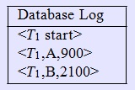
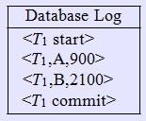
Deferred Database Modification...
Case-1: Crash occurs just before <T1 commit>
When the system recovers, no redo actions need to be taken, because no commit record appears in the log. The log records of the incomplete transaction T1 can be deleted from the log
Case-2 Crash occurs just after <T1 commit>
When the system recovers, the operation redo(T1) is performed since the record <T1 commit> appears in the log

Slide 75
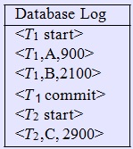
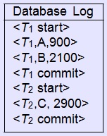
Deferred Database Modification...
Case-3: Crash occurs just before <T2 commit>
When the system recovers, the operation redo(T1) is performed since the record <T1 commit> appears in the log. The log records of the incomplete transaction T2 can be deleted from the log.
Case-4: Crash occurs just after <T2 commit>
When the system recovers, two commit records
are found in the log. Thus, the system must perform
operations redo(T1) and redo(T2) in the order in which
their commit records appear in the log.

Slide 76
Immediate Database Modification
This scheme allows database modifications to be output to the database while the transaction is still in the active state. Data modifications written by active transactions are called uncommitted modifications.
In the event of a crash or a transaction failure, the system must use the old-value field of the log records to restore the modified data items to the value they had prior to the start of the transaction. The undo operation accomplishes this restoration
The execution of transaction Ti proceeds as follows:
Before Ti starts its execution, the system writes the record <Ti start> to the log
During its execution, any write(X) operation by Ti is preceded by the writing of the appropriate new update record to the log
When Ti partially commits, the system writes the record <Ti commit> to the log

Slide 77
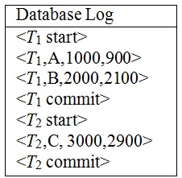
Immediate Database Modification…
The recovery scheme uses two recovery procedures:
Undo(Ti ): It restores the value of all data items updated by transaction Ti to the old values.
Redo(Ti ): It sets the value of all data items updated by transaction Ti to the new values.
The undo and redo operations must be idempotent.
Transaction Ti needs to be undone if the log contains the record <Ti start>, but doesn’t contain the record <Ti commit>.
Transaction Ti needs to be redone if the log contains both the record <Ti start> and the record <Ti commit>.

Slide 78

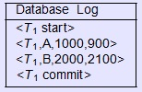
Immediate Database Modification…
Case-1: Crash occurs just before <T1 commit>
When the system recovers, it finds the record <T1 start> in the log, but no corresponding <T1 commit> record. Thus, T1 must be undone, so an undo(T1) is performed
Case-2 Crash occurs just after <T1 commit>
When the system recovers, the operation redo(T1) must be performed since the log contains both the record <T1 start> and the record <T1 commit>

Slide 79
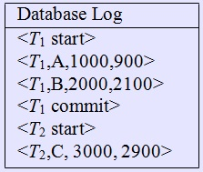
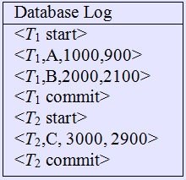
Immediate Database Modification…
Case-3: Crash occurs just before <T2 commit>
When the system recovers, two recovery actions need to be taken. The undo(T2) must be performed, because the record <T2 start> appears in the log, but there is no record <T2 commit>. The operation redo(T1) must be performed since the log contains both the record <T1 start> and the record <T1 commit>.
Case-4: Crash occurs just after <T2 commit>
When the system recovers, both T1 and T2 need to be redone, since the records <T1 start> and <T1 commit> appear in the log, as do the records <T2 start> and <T2 commit>

Slide 80
Checkpoints
The checkpoint is a type of mechanism where all the previous logs are removed from the system and permanently stored in the storage disk.
The checkpoint is like a bookmark. While the execution of the transaction, such checkpoints are marked, and the transaction is executed then using the steps of the transaction, the log files will be created.
When it reaches to the checkpoint, then the transaction will be updated into the database, and till that point, the entire log file will be removed from the file. Then the log file is updated with the new step of transaction till next checkpoint and so on.
The checkpoint is used to declare a point before which the DBMS was in the consistent state, and all transactions were committed.

Slide 81
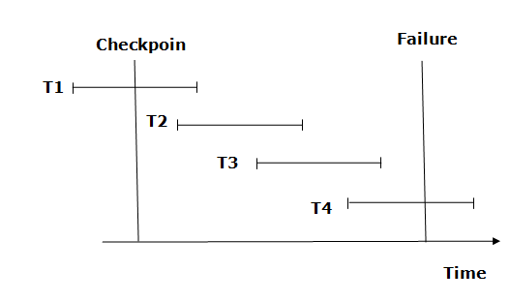
Recovery using Checkpoint

Slide 82
Checkpoints
The recovery system reads log files from the end to start. It reads log files from T4 to T1.
Recovery system maintains two lists, a redo-list, and an undo-list.
The transaction is put into redo state if the recovery system sees a log with <Tn, Start> and <Tn, Commit> or just <Tn, Commit>. In the redo-list and their previous list, all the transactions are removed and then redone before saving their logs.
For example: In the log file, transaction T2 and T3 will have <Tn, Start> and <Tn, Commit>. The T1 transaction will have only <Tn, commit> in the log file. That's why the transaction is committed after the checkpoint is crossed. Hence it puts T1, T2 and T3 transaction into redo list.
The transaction is put into undo state if the recovery system sees a log with <Tn, Start> but no commit or abort log found. In the undo-list, all the transactions are undone, and their logs are removed.
For example: Transaction T4 will have <Tn, Start>. So T4 will be put into undo list since this transaction is not yet complete and failed amid.

